Slide 1
Multi morbidity programme
Providers software review.
Task and finish group
06.02.2024

Slide 2
AIM
To support practices to enable efficient system and process
OBJECTIVES
Shortlist the nine providers to 3-4 providers favourites
Go through the pros and cons list for the favourites
Rate the features out of five *****
Agree the questions to ask the favourite providers

Slide 3
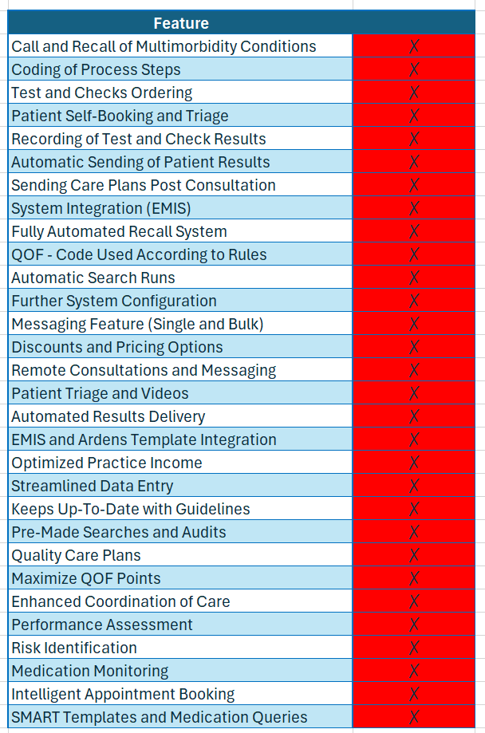

Slide 4
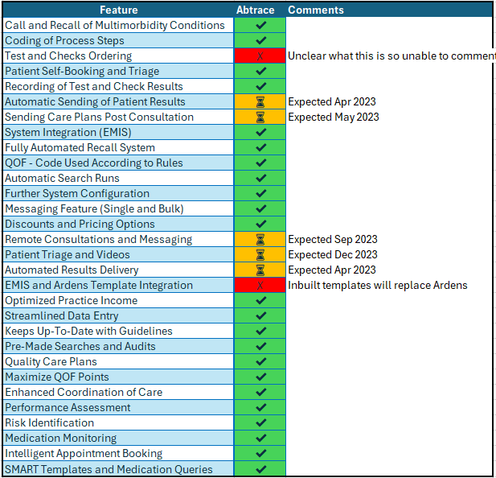

Slide 5
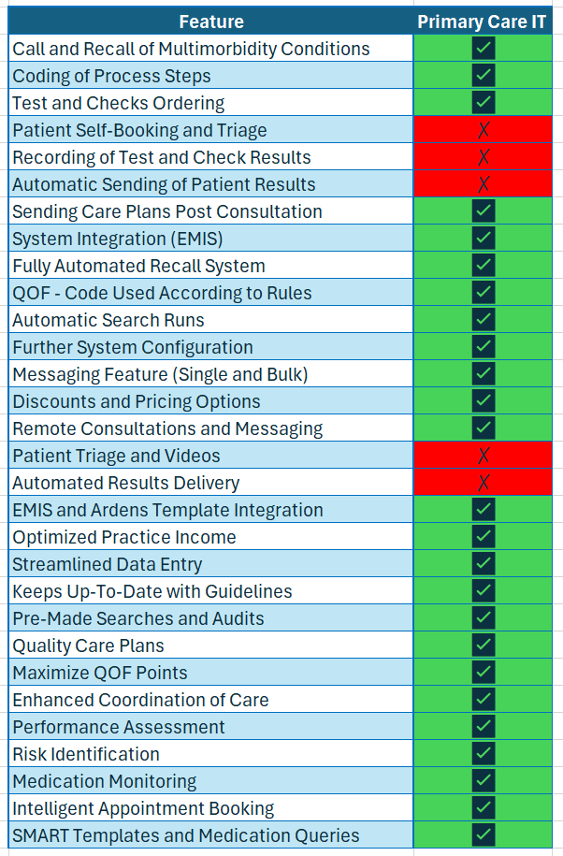
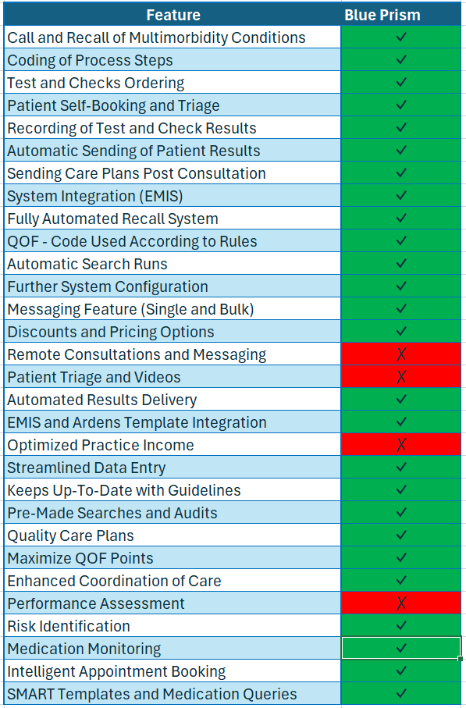

Slide 6
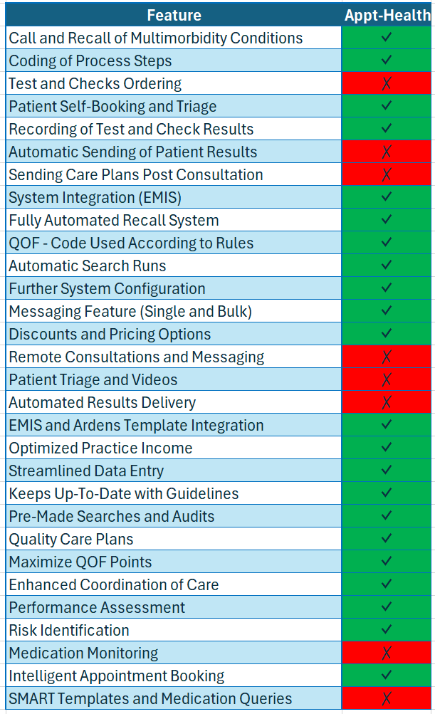
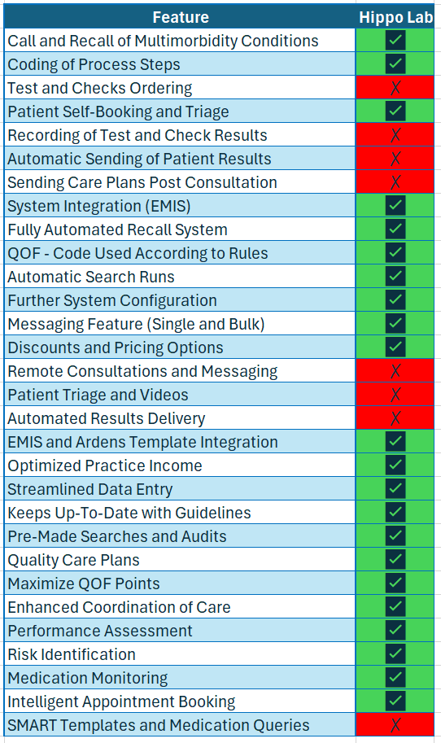

Slide 7
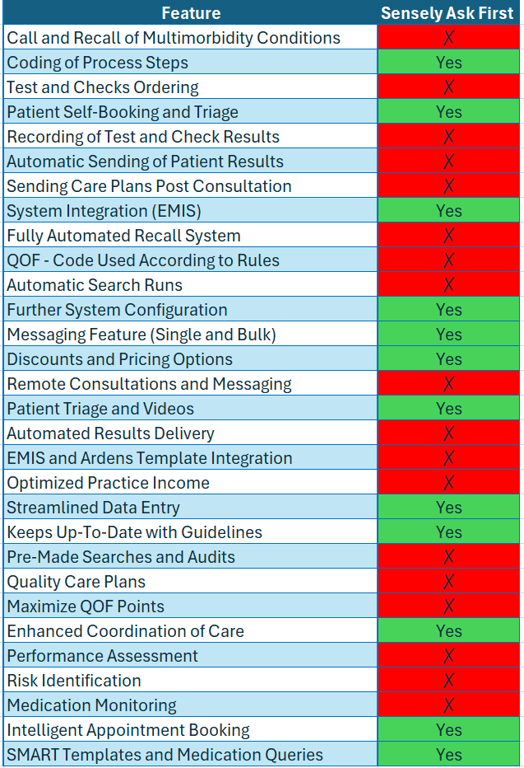
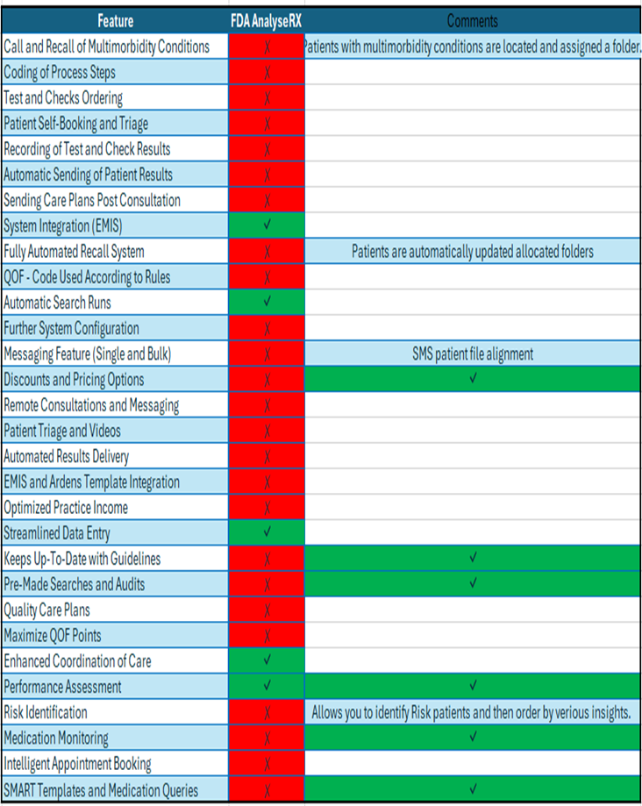

Slide 8
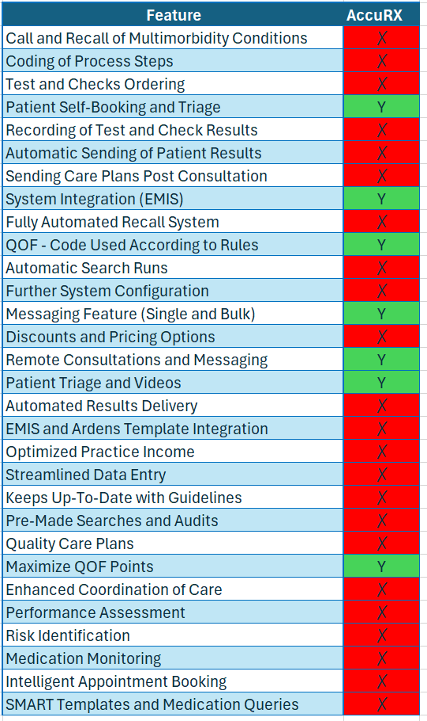
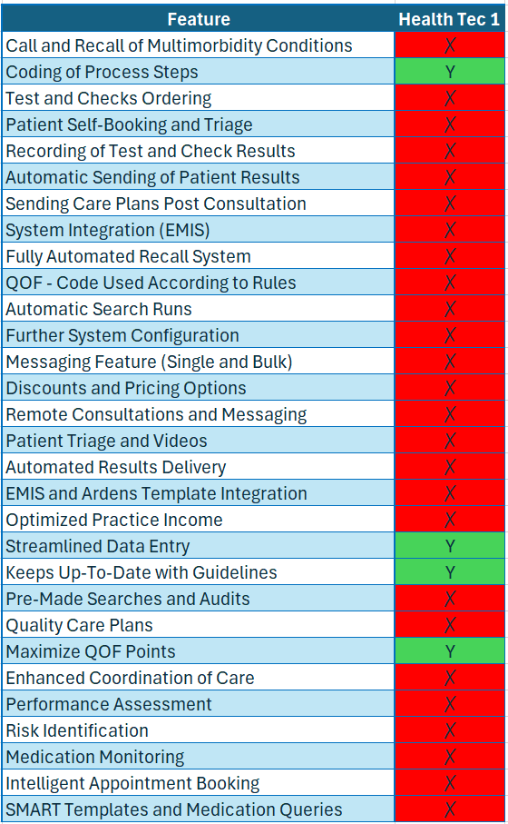

Slide 9
Blue prism | Primary care IT | Hippo labs | Abtrace | Apt health | Accurx | Sensely | Analyse RX | Health Tech 1
Details on costs not provided In order to provide you with accurate pricing, They need to know what processes you are looking to automate. | - Only available via subscription packages GP Contract - One off payment £795 ps- Annual fee 15p pp One Results | -‘standard’ pricing for practices is up to £1.50 per patient per year, -Normally include the messaging costs as part of our package It can be as low 85p at scale | End to end call and recall 66p per patient; No extra charges for text | £0.40 per successful booking £0.0199 (1.99 pence) per text message £0.90 per letter | In terms of cost, the current license fee for our Messaging products (SMS, Batch, Appointment Reminders and Questionnaires) covers the entire population of SWL. | Depending on population coverage this will vary from between 25p to 30p per patient This is a fixed cost and the tool can be used at practice / PCN and borough-wide level .

Slide 10
Blue prism | Primary care IT | Hippo labs | Abtrace | Apt health | Accurx | Sensely | Analyse RX | Health Tech 1
 | - One off payment £495 ps - Annual fee 10p pp One Monitoring - One off payment £495 ps - Annual fee 10p pp Referral Tree - One off payment £1495 ps - Annual fee 15p pp PTP - One off payment £495 ps - | it varies depending on exact implementation and scale. | 20% discount at PCN level dropping the price to £0.53/patient at PCN or above | If practices need a robot built in to make calls, this can be done at an additional costs. No charge any onboarding fees or other license fees | However, this does not apply to the cost of any SMS fragments, which are billed on usage.

Slide 11
Blue prism | Primary care IT | Hippo labs | Abtrace | Apt health | Accurx | Sensely | Analyse RX | Health Tech 1
 | - One off payment £495 ps - Annual fee 10p pp One Monitoring - One off payment £495 ps - Annual fee 10p pp Referral Tree - One off payment £1495 ps - Annual fee 15p pp PTP | it varies depending on exact implementation and scale. | 20% discount at PCN level dropping the price to £0.53/patient at PCN or above | If practices need a robot built in to make calls, this can be done at an additional costs. No charge any onboarding fees or other license fees | No charge any onboarding fees or other license fees – and the pricing is the same for individual practices and for PCNs.

Slide 12
Blue prism | Primary care IT | Hippo labs | Abtrace | Apt health | Accurx | Sensely | Analyse RX | Health Tech 1
 | - One off payment £495 ps - Annual fee 10p pp One Contact - One off payment £0 - Annual fee 20p pp EMIS Subscription Package Fees - One Off Install Fee per site £995 ps - EMIS enhanced PCIT toolset £995 ps | normally include the messaging costs as part of our package, but happy to construct something more bespoke to your needs |  | pricing is the same for individual practices and for PCNs. Happy to discuss volume pricing with individual boroughs.

Slide 13
Task and Finish Group Recommendations
A small group including primary care staff, HIN and LTC team reviewed software enablers for call and recall and also explored other functionality
The group strongly agreed to proceed with these three.
Abtrace
Primary care IT
Blue prism
Further questions were asked of each of the providers. Q&A’s available.

