Slide 1
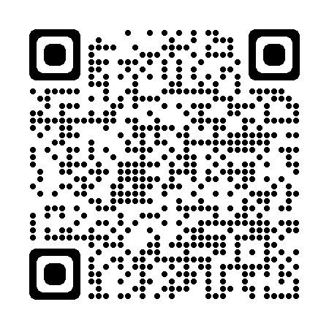
Using the NHS App:
Guidance and training materials for GP practices
Important: Check you are using the latest version of this document as it is constantly updated.
Scan this QR code or visit this FutureNHS link

Slide 2
Version Control
Document title | Using the NHS App: Guidance and training materials for GP practices
Version | 1.2 Note: Updated versions will be uploaded to the FutureNHS platform. Please regularly visit this link to check you are using the most updated version of this pack.
Author | Tara Bush – Programme Manager, Digital Transformation – Primary Care (London Region), NHS England
Date published | 18th October 2023
Last updated | 17th January 2024
Please note: The screenshots and descriptions in this document have been updated to reflect the redesign of the NHS App in Dec 2023.
It is important to note that some services may have moved within the NHS App, but all the services patients need will still be available.
This pack currently signposts to existing national and local resources which are yet to be updated to reflect changes in the design of the App.
Should you have any queries relating to this document, please contact england.londondtt@nhs.net

Slide 3
About this document
This document provides guidance, tips and links to useful resources to help practices better understand what they need to do to promote and maximise the features available to their patients via the NHS App.
All GP practices in England are connected to the NHS App. This means that anyone aged 13 and over and registered with a GP practice in England can use it. A key theme of the Primary Care Access Recovery Plan is around empowering patients to manage their own health, with a focus on rolling out existing NHS App functionality to 90% of practices by March 2024.
The video on the right shows at a glance how the NHS App is laid out and where different services are listed.
The key functionalities of the NHS App have been listed on the next slide, with the ability to click to navigate to further information about each of them, including:
what each feature allows patients to do in the NHS App
how these services can support your operational processes
links to guidance on what you may need to do to ensure your patients are able to access these features
tips on how you can ensure effective uptake of these features by patients
It is important to note that every practice operates differently, and it is up to them to make decisions about implementing these services in a way that best suits how they work.

Slide 4
How to use this document
This document contains interactive elements so that users can easily navigate to preferred areas of interest.
For the best viewing experience, we recommend opening this document in Microsoft PowerPoint and clicking on ‘Slide Show’; alternatively, you can press Ctrl + Click to follow each link.
There are several graphics used throughout the document, each providing a summary of:
Information and resources, outlining how to access certain features and what they can be used for
Important information that GP practices should be aware of
What your practice needs to do
Actions for your GP practice to make the most of what the NHS App has to offer
Key benefits for GP practices and/or patients
Important information that patients should be made aware of
Top tips for GP practices
Users can click on this icon to navigate to the contents page

Slide 5
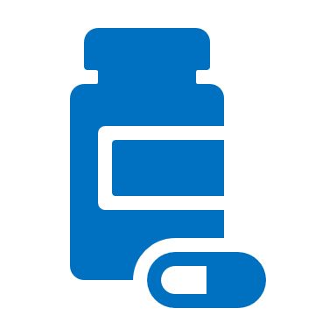
Contents Page
Click the text to find out more
Services
Your health
Other
Request repeat prescriptions
Contact your GP surgery about a health problem or for a document/update using an online form*
Book/check/cancel a GP appointment*
Get medical help via 111 online
Find NHS services near you
Register with a GP surgery*
Access health information (Health and Medicines A-Z)
View GP health record securely
View test results and care plans*
Nominate a preferred pharmacy
View a prescription barcode
Book your first hospital or clinic appointment
Manage hospital and other appointments*
Manage your organ donation decision
Update data sharing preferences
Register to take part in health research
Find your NHS number
Receive notifications and messages from your GP*
Manage services for another person (proxy access)*
Useful information
Patients registering for the NHS App
Practice benefits of using the NHS App
Tracking your practice’s NHS App data
Examples of good practice
Communications and promotional material
Further resources to support you
* Note: these services may be available to patients depending on their level of access and what has been enabled by the practice

Slide 6
Patients registering for the NHS App
Patients can download and install the NHS App on the Google Play (Android device) or App Store (Apple device). They will then be prompted to sign in with their NHS login. They can also log in through the NHS website.
How it works
Patients can set up an NHS login account by entering their email address and creating a password, after which they will receive an email asking them to log in. They will also be asked to enter their mobile phone number and enter the security code received by SMS.
Patients will need to prove their identity by either:
sending a photo of their ID (UK/EU driving license of passport or European national ID card) and recording a video of their face while they say 4 random numbers shown to them
entering registration details they have obtained from their GP practice, e.g. linkage key, practice ID/ODS code and an account ID
It will then ask them for their NHS number. They can either find it here, or they will be prompted to enter their name, date of birth and postcode.
They will need to wait for up to 2 hours for their information to be checked. They will receive an email to confirm their have passed all the checks and be able to use their NHS login to sign
in. When logging in, they will be asked for their email and password, and to enter a security
code sent to their mobile phone number.
Tips for practices
Get your practice team to download the app and/or set up a test patient to see what it will look like for patients
Read the step-by-step guidance on getting patients started with NHS login
Upskill a practice staff member or ask your digital champions / facilitators to attend community events or support patients in the practice with registering and using the NHS App
Use these materials to promote the NHS App on your website, social media, telephone lines and within the practice.
Communicate the benefits to your staff
Ensuring that your patients are fully registered with the NHS App
Patients will need to click ‘Connect to their GP surgery’ and accept conditions of use for access to the full range of features. If the GP surgery is not connected, they can only use the app to check their symptoms and find out what to do if they need help urgently.

Slide 7
Practice benefits of using the NHS App
The NHS App provides a simple and secure way for your patients to access a range of NHS services. There are several benefits of using the NHS App for GP practices, many of which lead to increased operational efficiencies and improved experience for both staff and patients.
Reduces text messaging and postage costs by sending messages for free via the NHS App
Reduces administrative requests (such as booking appointments and ordering prescriptions) which frees up time for practice staff to work on higher value tasks
Reduces the volume of phone calls and visits to the practice
Time released to support improvements to other services, including providing a better experience for patients (especially those who still prefer to, or need to visit or use the phone)
Reduces DNAs as patients can cancel appointments more easily
Patients can verify their identity themselves through NHS Login, which saves practice time
Improved communication between patients and practices, leading to higher levels of satisfaction
Empowers patients to undertake simple tasks without needing to contact their practice
Sharing of information supports increased patient safety, including fewer mistakes, duplications and complaints

Slide 8
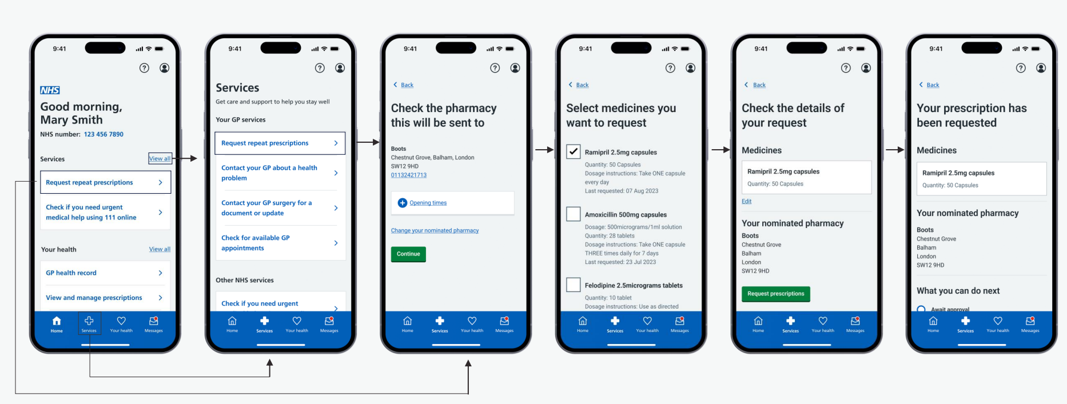
Request repeat prescriptions
Patients can request repeat prescriptions if the medication item is available to order, and they can view their previous orders through the NHS App.
How it works
This feature can be accessed on the homepage or by clicking on the ‘Services’ icon and selecting ‘Request repeat prescriptions’. Patients can view or nominate their chosen pharmacy in this section. After selecting the medicine(s) they want to order, the request is sent directly to the GP surgery for sign-off and issued to the nominated pharmacy.
Orders can be made at any time, even when the surgery is closed. Once an order is placed, they can view their repeat prescriptions status and history, including when an item was last ordered.
Click here for a step-by-step guide or watch this short video showing how to request prescriptions via the NHS App.
Benefits:
Tips for practices
What your practice can do
Click here to download digital and print promotional materials to promote the repeat prescriptions feature to your patients
Consider streamlining the number of ways patients can request repeat prescriptions to avoid confusion – communicate any changes and always include options for the digitally excluded
Review protocols to ensure only suitable items are on repeat and available to order. You can also add reasons for taking medication into the directions e.g. ‘take one in the morning for blood pressure’.
Ensure information on your website relating to prescriptions is updated and encourages patients to use the NHS App - here is a good example
Less administrative workload, e.g. transcribing email or paper requests
Fewer transcription errors
Improved audit trails
Shows when prescriptions are issued and ready for collection, reducing calls or visits to the practice

Slide 9
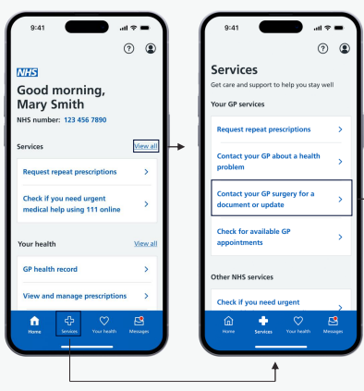
Contact your GP surgery about a health problem or for a document/update using an online form
Patients can submit symptoms or requests for support through the NHS App and receive appropriate triage or referral prior to a consultation. Note: this feature is only available for patients registered at practices using an online consultation supplier that has integrated with the NHS App.
How it works
Patients can access online consultations in the NHS App by clicking on the ‘Services’ icon.
For medical advice, they can click on ‘Contact your GP about a health problem’. They will be instructed to fill in the online form with information about their symptoms, conditions or treatment (or on someone else’s behalf).
They can also click on ‘Contact your GP surgery for a document or update’ to submit an admin query, such as requesting help with sick notes or GP letters.
Once submitted, a GP or another professional reviews the form. They then decide on the right care for the patient, e.g. email/message with advice or information, telephone or video consultation, or face-to-face appointment. Patients are directed to seek acute care if they hit a red flag.
What your practice can do
Benefits:
Your practice doesn’t need to do anything if it already uses an online consultation system that is integrated with the app
Refer to this handbook for tips on making best use of online consultations
Let your patients know that this service is available via the NHS App – view the promotional materials and suggested wording for SMS/websites
More convenient - patients don’t need to call or attend the surgery
Same experience for users and GP surgery staff – details entered in the NHS App are seamlessly passed into the online consultation system
For urgent medical help, patients should call the practice before contacting 111 or 111.nhs.uk. For emergencies, they should always be advised to ring 999 or go to their nearest A&E. Patients should NOT use online forms for urgent (same day) problems, unless the practice has a process for this.

Slide 10
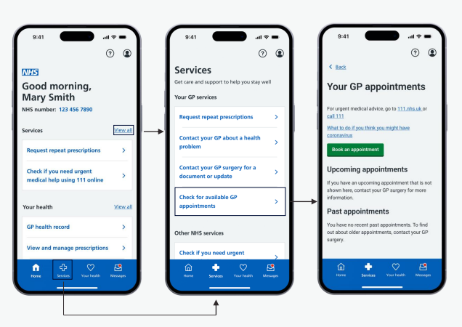
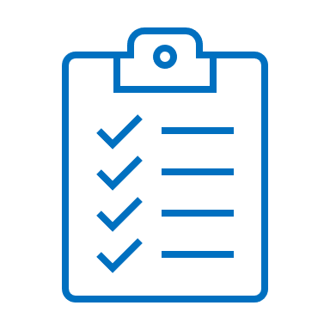
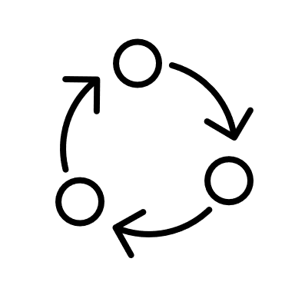
Book/check/cancel a GP appointment
Patients may be able to book and manage GP appointments via the NHS App if their GP surgery has made these available online. Making all “directly bookable” appointments available online, as well as by phone/in-person, is a new contractual requirement – this includes those that do not need to go through a triage process.
How it works
Patients can access this feature by selecting ‘Services’ icon and then clicking ‘Check for available GP appointments’
What your practice needs to do to set this up
Naming appointments
Use simple language when naming appointments so patients know what they are for - avoid clinical terms
Make the appointment type clear, e.g. phone or online
Clearly state the purpose of the appointment and the patient group it’s for
Click here for instructions on naming appointments in your clinical system.
You’ll need to enable online appointment booking. The NHS App will show any appointments you have made available for online booking within the next 16 weeks, but you can decide how far in advance appointments are available to book.
Click here for guidance on how to make appointments available within your clinical system. Set up a test patient once you’ve amended the settings to see how it appears in the app.
Click here for some tips on features you can use to support your processes
Benefits:
Tips for practices
Relieves some of administrative workload by reducing patient phone calls and visits
Improved communication between patients and practices
Increased operational efficiencies
Higher levels of patient satisfaction
Can decrease waiting times by reducing DNAs
Try to open up appointments for online booking in a staged approach and gradually extend the number and type of appointments enabled
See guidance on improving accuracy of appointment recording here
Let your patients know if you are using this service – use these promotional resources or signpost them to further support here

Slide 11
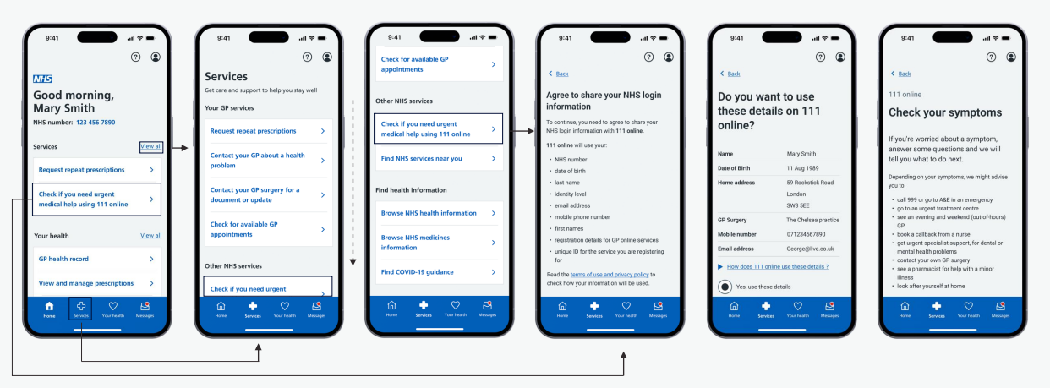
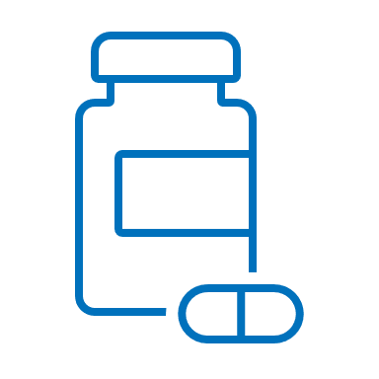
Get medical help via 111 online
Patients can use this digital triage service to answer questions and get instant advice or urgent medical help near them. It is available 24/7 and is for those aged 5+. It can direct patients to the best place to get help if they cannot contact their GP during the day, or if their GP is closed (out-of-hours).
How it works
Patients can access this feature from the homepage or by clicking on the ‘Services’ icon. After entering their age, sex, postcode and main symptom, they are then asked a series of questions about their health problem. They can:
be signposted to the right healthcare in their area, such as whether they need to see a GP, dentist, consult with a pharmacist or seek urgent care
get advice on self-care to manage their condition at home
get advice on what to do if their condition gets worse
be referred to their local 111 service for a call back from a nurse, doctor or other trained health professional if they need it
request a limited emergency supply of regularly prescribed medicine they’ve run out of
Benefits:
Makes it easier for patients to get the treatment they need in the right place
Empowers people to manage their own health and care
Manages demand on NHS 111 telephone service
111 online cannot:
Issue fit notes – patients need to contact their GP
Make or cancel appointments in other parts of the NHS
Patients can call 111 to speak to someone if they:
have urgent care needs that require help immediately or are not sure what to do
need medical advice for a child under five
Patients with a medical emergency should always be advised to ring 999 or go to A&E instead.

Slide 12
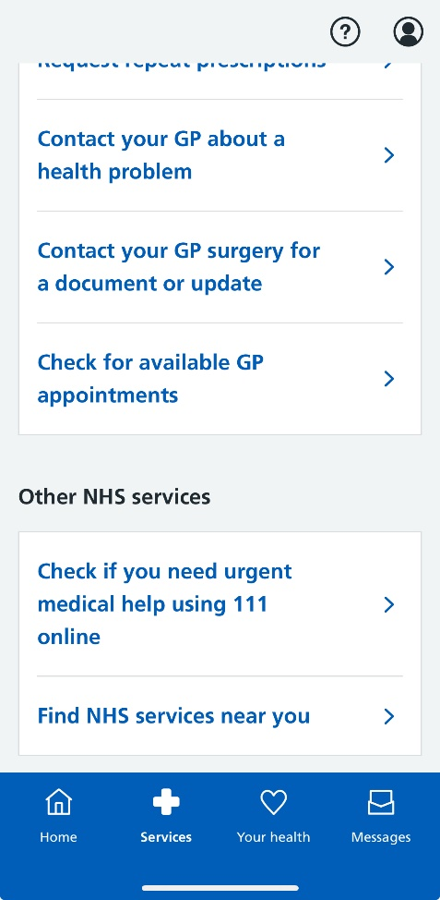
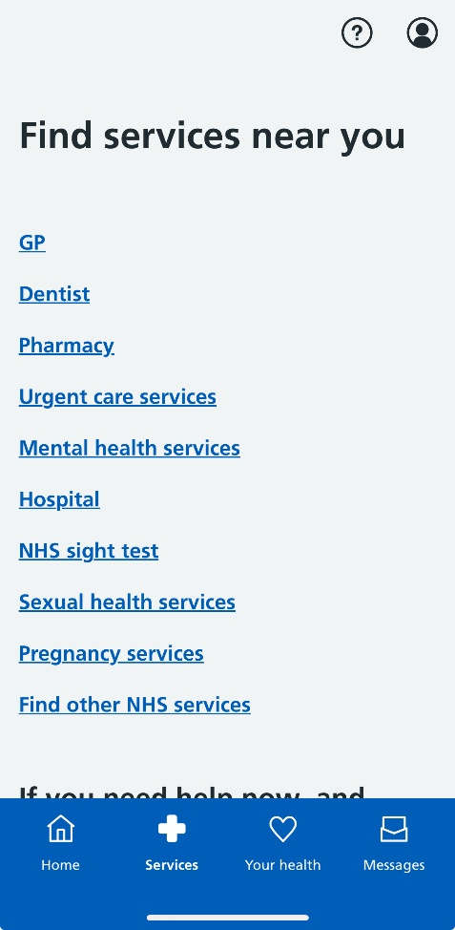
Find NHS services near you
Patients can use the NHS App to view a list of NHS services near them, such as local GP surgeries, dentists, pharmacies and more.
How it works
Patients can access this feature by clicking on the ‘Services’ icon, scrolling down to ‘Other NHS services’ and selecting ‘Find NHS services near you’
They will then be able to view a list of NHS services and asked to enter their postcode to find these services near them
As well as this, within each section there is some great advice and information, like how to register with a GP and a link to mental health helplines and support
If patients need help immediately or are not sure what to do, they can go to 111.nhs.uk or call 111
Benefits:
Patients have easy access to accurate service information
Increased awareness of available services, directing patients to the right service first time
Shift to lower acuity services where appropriate, reducing GP surgery demand
Improved patient experience
Patients with a medical emergency should always be advised to ring 999 or go to A&E instead.

Slide 13
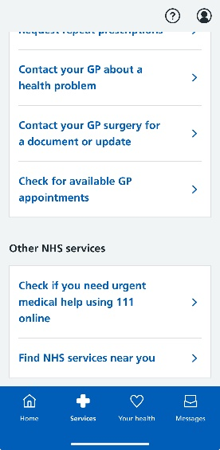
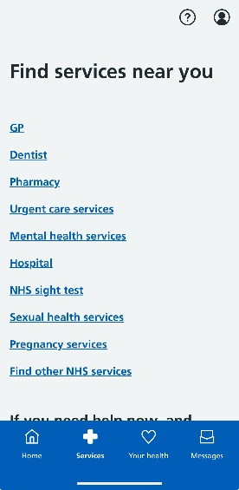
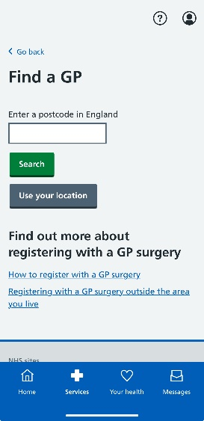
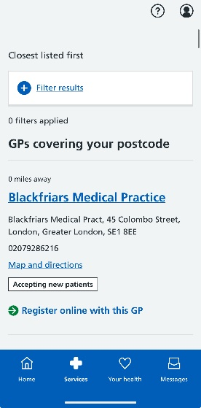
Register with a GP surgery
Patients can find a GP and apply to register themselves or someone they care for via the NHS App, but only if their GP has enrolled with this service. It is simpler, easier and more inclusive for both patients and GP surgeries, whilst also reducing the administrative time required to complete the process.
How it works
Patients can access this service by clicking on the ‘Services’ icon and selecting ‘Find NHS services near you’ > ‘GP’. After entering their postcode, they can click to ‘Register online with this GP’ if that GP surgery has enrolled with the service.
You can view a step-by step guide for patients here. Watch this demo on how patients can register with a GP via the App.
There is also an updated paper form for patients with limited or no access to the online service which you can download here
Benefits:
What your practice needs to do to set this up
Can halve the time taken to register a patient – it should only take practice staff 10-15 minutes
Validates answers provided by the patient to improve the accuracy of registration information
Can use NHS login, which is less work for your surgery as patients will already have verified their identity
Standardises information needed to onboard a patient, making it easier to read and in the correct format
Free for patients and GP surgeries – your surgery could save up to £2,156 a year
Follows accessibility guidelines and regulations which minimises support needed from staff
Your surgery will need to enrol with the service to offer online registration to patients through the NHS App - click here to find out how to self-enrol
This webinar explains how practices can set up this service and there is also a resource hub for further details
Once enrolled, you can use these materials to promote the service

Slide 14
Access health information (Health and Medicines A-Z)
Patients can check their symptoms using the Health A-Z, which provides information and advice about a wide range of health conditions, symptoms and treatments. They can also access the Medicines A-Z for information on a range of prescribed and over the counter medications.
How it works
Patients can access health information on the NHS website via the ‘Services’ section.
The Health A-Z can be accessed by clicking on ‘Browse NHS health information’. It is a useful resource to find out about a current diagnosis and to get information on treatment. It can also help patients to self-diagnose non-serious medical conditions.
The Medicines A-Z can be accessed by clicking on ‘Browse NHS medicines information. It provides information about medication, such as how and when to take it, side effects and common questions.
Benefits:
Empowers patients to manage their own health, directing them to high quality, trusted information
Can reduce the number of calls and visits to the practice, as well as potentially avoidable appointments, thereby releasing time for practice staff to deal with more urgent cases
Patients with a medical emergency should always be advised to ring 999 or go to A&E instead.

Slide 15
View GP health record securely
Patients can view their GP health record through the NHS App, NHS website or other GP online services/apps to make it easier for them to understand and make choices about their health. They can view information about their medicines, conditions, test results and more. They can also access someone else’s records if authorised to do so.
How it works
Patients can access their records by clicking on ‘GP health record’ on the homepage or in the ‘Your health’ section. A security message will flag that they will be accessing personal and sensitive data.
- Summary Care Record – patients can see information about their medicines and allergies
- Detailed Coded Record – patients need to contact their GP surgery to request access to information such as test results and immunisations
Most patients will automatically be given access to information added to their record from November 2023 onwards. This includes letters, test results and appointment notes. Some may also have access to information added before this date. Further details and support can be found here.
Benefits:
Prospective record access - changes to 2023/24 GP contract
What your practice needs to do
From Nov 2023 onwards, new entries in the GP record will be visible to all patients aged 16+ and with an online account - unless they have decided to opt-out or any exceptions apply. See the GP readiness checklist and bitesize videos or speak to your local commissioner for further support. You can also:
watch this webinar on safeguarding and reducing harm
view these case studies to understand the benefits of record access
view the guidance on updating clinical system configuration settings
Any changes to your workflow should be clearly documented and understood by staff - ensure that any sensitive or third-party information is redacted and know when it may be inappropriate to give a patient access to their record. You can review or remove access at any point. Find out more here.
See guidance and FAQs to support your staff with switching on record access.
Use these resources to promote record access via the NHS App
Reduces patient queries related to test results or referrals, which saves staff time
Empowers patients to manage their health and care
Reduces costs associated with printing and sending letters, also reducing carbon footprint

Slide 16
View test results and care plans
Patients can view their test results carried out by their GP surgery if they have been given access to their detailed coded record. They may also be able to view hospital test results if they have access to their personal health record in their NHS App.
How it works
Patients can access this service by clicking on ‘GP health record’ on the ‘Home’ screen, or via the ‘Your health’ icon, and selecting ‘Test results’.
Test results from the GP surgery or hospital are listed once checked and filed to the record by a GP. Patients will be contacted if there is a need to discuss the results further. They can see previous test results by clicking ‘View all test results’.
If their GP surgery or hospital supports this service, patients can manage their personal health record, which stores information about their health and care online. Health professionals can add information to this. They may also be able to view and manage their care plans. This usually includes an action plan, with details about their care, health goals and advice on monitoring their conditions.
Benefits:
What your practice needs to do
Find out how to enable detailed coded record access here
Encourage patients to check their results on the NHS App and explain the benefits of them viewing their results online
Ensure practice staff are aware that patients will be able to see their results and any comments once they have been reviewed/filed. Sensitive results should be redacted or hidden as they are filed.
Saves admin and clinical team time and reduces the number of phone calls from patients
Supports patients to better understand and manage their own health, particularly those with long-term conditions
Improves communication between health professionals and patients, which leads to improved patient satisfaction

Slide 17
Nominate a preferred pharmacy
Patients can choose where to collect their prescription after it has been issued by the GP – this is called a nominated pharmacy.
How it works
Patients can access this feature by selecting ‘View and manage prescriptions’ on the homepage (or via the ‘Your health’ icon) and clicking on ‘Your nominated pharmacy’
To makes any changes, they can select 'Change your nominated pharmacy’. Click here for further guidance.
Once a patient nominates a pharmacy:
The nominated pharmacy will receive their prescriptions until they change or remove this nomination
They can change their nominated pharmacy at any time, although it is best to do so before they order any items. Any outstanding prescriptions already ordered and in transit will be delivered to the pharmacy nominated at the time of the request.
They no longer need to collect paper prescriptions from their GP surgery
They cannot remove a nominated pharmacy in the NHS App and will need to contact their GP surgery to ask them to remove this for them
Benefits:
Patients can collect their medicine from a pharmacy close to where they live or work.
Patients may not have to wait as long at the pharmacy – prescriptions can be prepared before they arrive

Slide 18
View a prescription barcode
Patients can access a prescription barcode in the NHS App to collect their medicine if they don’t have a nominated pharmacy. They can show the barcode to any pharmacy of their choice to get their medicines.
How it works
Patients can access this feature on the homepage by selecting ‘View and manage prescriptions’. This can also be found via the ‘Your health’ section. The barcode can be accessed by clicking ‘Your confirmed prescriptions’ and selecting the prescription they want to view. They can then click to expand the ‘Prescription barcode’ at the top of the screen.
The barcode can be presented to a pharmacist to collect the medicine without having to collect a paper prescription
Benefits:
Patients can avoid unnecessary journeys to collect a paper-based prescription from the GP
Saves time for dispensers as they can scan digital barcodes rather than performing a manual search for prescriptions
Reduces the amount of paper processing required
Can reduce prescribing errors

Slide 19
Book your first hospital or clinic appointment
Patients can use the NHS App to book and manage hospital or clinic appointments if their GP surgery has referred them to a specialist and providing the hospital has enabled the function and is linked to the NHS App. Patients can use the NHS e-Referral Service to choose the place, time and date for their first appointment. Multiple referrals can be managed at any time, as long as they are first appointments.
How it works
Patients can access this service by clicking ‘Your health’ > ‘Upcoming and past appointments’ > ‘Hospital referrals and appointments’ > ‘Book or manage this referral’. For directly bookable referrals, they can then select the clinic they’d like to attend, plus the date/time, from the options available. Once booked, they can ‘View details’ and cancel their appointment if needed. For indirectly bookable referrals, the clinic will send a date/time and the patient is able to confirm this appointment.
Patients can only book hospital appointments in their App if they have been referred through the NHS e-Referral Service
Patients cannot manage any further appointments for an existing referral - this must be done with the specialist they’re referred to
Benefits:
Patients can manage their appointments 24/7 without needing to contact the practice
Can save practice time and money
Reduces the likelihood of patients not being aware of their referral or how to progress them
Reduces DNA rate, avoiding practices having to refer these patients again
What your practice can do
Talk to your patients about managing their referral online.
Download this video to play in your waiting room. A PowerPoint and YouTube version are also available.
Update your website/social media – see templates here
Continue to support patients who don’t have access to online services and for more urgent appointments
Read the advice and guidance toolkit to find out how your staff can get the most out of the NHS e-Referral Service

Slide 20
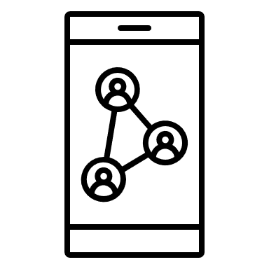
Manage hospital and other appointments
This service delivers functionality to allow patients to access and manage secondary care appointments and referrals through the NHS App. It works by surfacing information from Patient Engagement Portals (PEPs) at a Trust into the NHS App. This means that patients will be able to see all their appointments in one place on the NHS App, regardless of the Trust or PEP provider. Find out more here.
How it works
Patients can access this service by clicking on ‘Your health’ > ‘Upcoming and past appointments’ > ‘Hospital referrals and appointments’. Patients can take any action needed or view more details by selecting the relevant link next to the referral or appointment. All GP practices associated with a participating acute trust will have the following features activated:
Benefits:
More consistent user experience through one single point of entry to NHS services
Patients have more visibility and control over appointment bookings, reducing DNAs
Reduced administrative burden, e.g. less queries about status and waiting times
Patients can access supporting information to help prepare for hospital appointments
Patients are more informed about their care and waiting times, improving experience
all referrals and future hospital appointments in one place
see a single point of contact for each appointment
access supporting information
notifications and messaging
book, change or cancel hospital appointments
documents
questionnaires
paperless preferences
What your practice needs to know
Further information
GP practices do not have control over the integration with hospital-based services. Patients can still use the PEP directly if this functionality isn’t available within the App.
Patients can check information from hospital appointments they’ve already attended once this is sent to the GP practice - in the ‘document’ section of their online GP record
Promotional material
Example comms pack for acute trusts
FAQs
See a list of trusts using this feature
Contact the Wayfinder team with any queries

Slide 21
Manage your organ donation decision
Patients can register their decision to be an organ donor on the NHS App. The law around organ donation in England has recently changed, with the introduction of an ‘opt-out system’. This means that all adults are now considered to have agreed to be an organ donor when they die unless they specifically record a decision not to donate. Find out more about organ donation law here.
How it works
Patients can access this service by clicking on the ‘Your health’ icon > ‘Your health choices’ > ‘Make your organ donation decision’. They will be able to see their current decision, and confirm or change this, if it has been registered previously. If a decision has not yet been registered, they will be able to do so by following the on-screen instructions.
Patients can choose whether or not to donate their organs and select which organs they would be willing to donate. They can amend their decision at any time. If organ donation is a possibility, their families will still be consulted before this goes ahead.
Find out more here.
This short video demonstrates how to manage organ donation decisions via the NHS App.
Benefits:
Helps NHS specialist nurses to quickly understand people’s wishes, which can ultimately save lives
Helps a patient’s family to understand their wishes so they can support their decision

Slide 22
Update data sharing preferences
Health records contain confidential patient information, which can be used to help the NHS with research and planning. Find out more here. Patients can opt out if they do not want their data to be used in this way. Their confidential patient information will still be used for their individual care.
How it works
Patients can view or change their current preference at any time by clicking on the ‘Your health’ icon (or ‘View all’ next to ‘Your health’ on the homepage) and selecting ‘'Your health choices' > ‘Choose about your health records data’. They can then read more about how data from their records is used. After clicking on ‘Make your choice > ‘Start now’, they can view their preference and/or update their choice by clicking ‘Submit’.
Patients do not need to do anything if they are happy with their confidential patient information being used for research and planning.
Patients cannot manage data sharing preferences on behalf of someone else using the NHS App or NHS website, but they can make a choice for someone else (e.g. children under the age of 13 or on behalf of another adult if power of attorney) by email or post. Click here for more details.
Benefits:
Quicker and easier way for patients to amend their data sharing preferences
Provides further information, enabling patients to make an informed decision
Helps build the public’s trust and confidence in the use of their data

Slide 23
Register to take part in health research
The “Be Part of Research” online service, which encourages members of the public to get involved in health research, is available through the NHS App. Patients can search for trials and studies taking place for particular health conditions they are interested in – or sign up as a healthy volunteer.
How it works
Patients can access this service by clicking on the ‘Your health’ icon (or ‘View all’ next to ‘Your health’ on the homepage) and selecting ‘'Your health choices' > ‘Be part of health research’
After clicking on ‘Start Registration’, patients are asked to agree to share their NHS login information with the service and can then begin the registration process by consenting for their information to be processed.
They are then matched to suitable studies in the UK based on the areas of interest they select, as well as age, ethnic group, sex, location and condition. This can range from lifestyle questionnaires to clinical trials taking place at local hospitals, GP practices or at home.
Benefits:
Helps researchers quickly find suitable participants
Can advance care and treatment for disease and improve the quality of care provided by the NHS

Slide 24
Find your NHS number
Anyone registered with a GP in England has an NHS number. An NHS number is a unique 10-digit number which helps healthcare staff identify people correctly and match their details to their health records. It links all their records together, creating a fuller, more accurate health history.
How it works
Once logged into the NHS App, patients can view their NHS number at the top of the ‘Home’ page.
Benefits:
Makes it easier for people to complete forms and access services, e.g. appointment booking, COVID-19 vaccinations
Fewer requests from patients which reduces workload for GP practice staff
Carbon neutral service due to fewer journeys to the practice and less notifications sent by letter
Supports joined-up healthcare across the various services
Other ways patients can find their NHS number
Documents and letters – prescriptions, test results, hospital referral letters, appointment letters
Online – patients can enter their name, date of birth and postcode using the Find your NHS number service online. Their NHS number will then be sent by text message, email or letter to the contact details held by their GP.
GP surgery – patients can call or visit their surgery with proof of identity

Slide 25
Receive notifications and messages from your GP
Patients in some practices can receive messages securely from their practice via NHS app instead of SMS, providing they have downloaded the app and switched on the notification toggle. ​This short video shows how patients can turn on notifications in the NHS App.
How it works
Patients can turn notifications on/off by clicking on the ‘Account’ icon on the top right corner > ‘Settings’ > ‘Manage notifications’ and using the toggle to set their preference.
Practice staff members create a message to the patient in the same way they are used to using their communication supplier of choice, such as Mjog, iPlato, Accurx etc.
The communication supplier automatically attempts to send a message to the patient using the appropriate channel (e.g. NHS App, another app). If the message is not read via the initial channel, it will automatically try the next priority channel (e.g. SMS).
Messages received via NHS App are stored in the inbox for that NHS number. If enabled, patients will receive a notification to let them know they have a new message.
Time-critical messages are not sent via NHS App.
What your practice needs to do to set this up
Check whether your messaging supplier offers NHS App messaging. If they do, ask them when they will be rolling this out in your practice. If they don’t, ask them to contact the app onboarding team at app.onboarding@nhs.net.
Find out how you can implement NHS App messaging by emailing england.nhseimplementation@nhs.net. See further information on the FutureNHS platform.
Update your privacy policy
Plan how you will tell patients about this service – check out these promotional materials and see guidance here
Benefits:
Supports a reduction in SMS costs – you can explore other ways to be more sustainable with messaging here
More secure than other channels like SMS
Messages can be longer and richer in content, e.g. with branding

Slide 26
Manage services for another person (proxy access)
Patients can request to act as a proxy for children, relatives or someone they care for. This allows them to access health services on behalf of someone else.
How it works
Patients will need to contact their GP surgery and ask them to register them for proxy access. They will then be able to access the linked profile by clicking on ‘Switch profiles’ on the homepage. A yellow banner at the top will show they are acting on behalf of someone else once they switch profiles. They can return to their own profile by selecting ‘Switch back to your profile’.
Patients can use linked profiles if:
they and the other person are both registered at the same GP surgery
their GP surgery has registered them for proxy access
their GP surgery uses EMIS (Patient Access) or TPP SystmOne (Airmid or SystmOnline)
Depending on the level of proxy access the surgery agrees to provide, they may be able to switch profiles to book an appointment, order a repeat prescription, or view some or all of their GP health record.
Carers can order medication by proxy which reduces the time spent processing requests from Medication Administration Record charts​ - see guidance here.
Benefits:
Can help ensure that information held by the surgery is correct, e.g. medication and allergies
Supports those who may not have access to GP online services
Reduced calls and/or visits to the GP surgery
What your practice needs to do to set this up
You can set up a linked profile for a patient by following the normal process in your clinical system. See the relevant guidance on how to add a proxy user in your clinical system: EMIS or TPP
Follow the existing guidelines for proxy access and identity verification provided by the RCGP. Patients will need to provide identification so that you can confirm who they are and check they are the correct person to act on the other person’s behalf.

Slide 27
Tracking your practice’s NHS App data
Practices can see how many of their patients have downloaded the NHS App and which features they are using by accessing the NHS App Reporting Dashboard.
What your practice needs to do to access this platform
You will need an OKTA account to access the dashboard. This is available to anyone with an NHS email address. You can register for an OKTA account by clicking here.
How it works
You can filter the data by time period (monthly/weekly), date and area, which can help to monitor your various promotion ideas
Click on ‘Uptake’ to view the number of downloads and registrations. The tabs provide a breakdown by region, ICB and GP.
Click on ‘Usage’ to view activity such as logins, appointments booked/cancelled, repeat prescriptions ordered and records viewed

Slide 28
Examples of good practice
Case studies
NHS App Innovation Projects – examples of local initiatives and materials produced to improve awareness of the NHS App
Reducing calls to order repeat prescriptions - Southlands Medical Group, North East & North Cumbria
Relieving pressure on primary care services – Solihull PCN
Making better use of digital tools - PHGH Doctors, Barnet
Encouraging usage of the NHS App - Boundary House Practice, Enfield
Increasing NHS App uptake amongst young people – Somerset ICB
NHS App animated videos in community languages - North East London
Tips for practices
Brief your staff and encourage them to download/use the NHS App to help them to confidently promote it
Discuss the NHS App during practice meetings
Configure your systems where appropriate
Update your practice website
Ask clinicians to promote the app after a consultation, e.g. tell patients they can use it to view their results
Signpost patients to help and support online
Ask reception and admin to promote, check and verify numbers and emails at every contact
Have a tablet/other device in reception to share information with patients and to support those who may not have confidence or digital access
Promote the app on the practice website and social media
Promote the app on the telephone as an alternative while patients wait
Tell patients that order a repeat prescription that they can do this via the app next time

Slide 29
Communications and promotional material
Resources
Promo videos (embedded on the right) to consider adding to your website, social media or presentations
NHS App promotional toolkit
General NHS App promotional materials – including leaflets, posters, images and message templates
Short NHS App promo video – South East London ICB
Promotional films for waiting room screens, social media and websites
Promotional videos translated in other languages
Promotional material for specific NHS App services
Resources aimed at increasing uptake of the NHS App – North East London Primary Care Portal
Support resources for volunteers, including easy read guides, translated guides and videos explaining how to register in other languages – Sussex ICS
Bitesize videos on how to use certain features
Example stakeholder toolkit - including social media copy and FAQs
Step-by-step guides – patient leaflets

Slide 30
Further resources to support you
Clinical system guidance
EMIS step-by-step guide - Offering online appointment booking
TPP step-by-step guide - Offering online appointment booking
Appointment configuration
Using a test patient
EMIS and TPP configuration for enabling online record access
Guidance on secure messaging: EMIS & TPP
How to add a proxy user: EMIS & TPP
Measuring improvement
Digital Journey Planner - Quality Improvement Action Plan
Somerset – Blueprint for increasing NHS App uptake and utilisation
Translated materials
Leaflet showing how to register with the NHS App: French, Italian and Portuguese
NHS App Repeat Prescription Waiting Room Screens (Translated)
NHS App explainer videos: Bengali, Romanian and Somali
Videos to explain the NHS App in key community languages
NHS App campaign poster: Arabic, Bengali, Gujarati, Polish, Punjabi, Romanian and Urdu
Further support and FAQs
NHS App help and support
Example FAQs for practice staff and digital champions

Slide 31
Offering Online Appointment Booking – EMIS (1)

Slide 32
Offering Online Appointment Booking – EMIS (2)

Slide 33
Offering Online Appointment Booking – EMIS (3)
To name appointments slots, go to the Appointments page and click on ‘Appts configuration’.
Click on ‘Slot Types’ > select ‘Add’

Slide 34
Offering Online Appointment Booking - SystmOne (1)
Access guidance from within SystmOne:
- Select 'Help' --> 'Launch Help Browser'
Search for 'online appointment"
Select '33 Setting up Online Services'
Click on 'Appointment Booking'

Slide 35
Offering Online Appointment Booking – SystmOne (2)

Slide 36
Offering Online Appointment Booking – SystmOne (3)

Slide 37
Offering Online Appointment Booking – SystmOne (4)
Access limited guidance from outside SystmOne:
https://tpp-uk.com/products/airmid/enabling-airmid/step-five/

Slide 38
Appointment configuration
Tips - Appointment Naming
Whilst practices differ in how they manage their appointments, there are very few that are not suitable or adaptable for online booking. Therefore, any appointments that do not need to go through a triage process, could be available for patients to book directly online, by phone and/or by visiting the practice.
GP surgeries can use embargos so that appointments become available online at the same time as your telephone lines open, making it fair for all patients whether they use the NHS App or not.
Do:
make it clear if the appointment is a telephone or online appointment - for example 'phone appointment - general’. Use simple language.
make the purpose of the appointment clear
state which group the appointment slot is for - for example 'women only: cervical screening'
Do not:
do not use clinical terms - think 'blood test' rather than 'phlebotomy’
do not use terms such as 'default' or 'embargo' - these will make no sense to patients
do not include the clinician's name, time or location - these will be displayed separately
Benefits:
Providing better access to specialist clinic appointments can help towards Quality and Outcomes Framework (QOF) and Enhanced Services (ES) targets.

Slide 39
Using a test patient
It's a good idea to set up a test patient so that you can check how your specific appointments and services appear to patients in the NHS App. This will not be a real patient.
How it works
The app works by connecting a patient to their GP record in your clinical system, so you need to set up a test patient in both the clinical system and the NHS App. Your test patient needs to be aged 16 or over and have an NHS number and account in your clinical system, with patient online services activated. You might already have a suitable account set up.
Record the full name, postcode, linkage key and account ID to use later. You need a test NHS number to use that's present on the central NHS system, Spine. If you don't have one, you can contact nhsapp@nhs.net to request one.
After you have set up your test patient, you can log in using these details to see what your patients see in the NHS App.
You will need:
a smart mobile phone or tablet to download the app
an email account (set up a free one if you don’t want to use one you already have)
a mobile phone number, so you can get a text message even if you’re using a tablet
the full name, postcode, linkage key and account ID of the test patient account the practice’s ODS code

